Slide 1
Vendos Home Assistant
Calvin Nguyen
Chu Shao
Derek Huynh
Kirsten Koa
Patrick Torbett

Slide 2
Personal Motivations for Project

Slide 3

WHAT CHANNEL IS
THE NETFLIX?
Notes:
Elderly family members were having trouble interacting with household appliances and devices
Modern Television Setups
Mobile Devices
Family members want reassurance that their elderly family members can always call for help even when not in reach of a phone

Slide 4
Project Goals

Slide 5
Project Goals
Cost-Effective
Kinect ($20), Arduino ($30), Other ($15.86)
No need to replace existing appliances
No need to do internal home modifications
Single hub for controlling household appliances and devices
Gesture & Voice Control
Monitor activity for accidents (future)

Slide 6
Implemented Features
TV controls
Turn ON/OFF
Volume and channel controls
Change to pre-specified channels
Light controls
Turn ON/OFF
Adjusting brightness
Oven
Pre-heating the oven
Voice-activated calling and text messaging

Slide 7
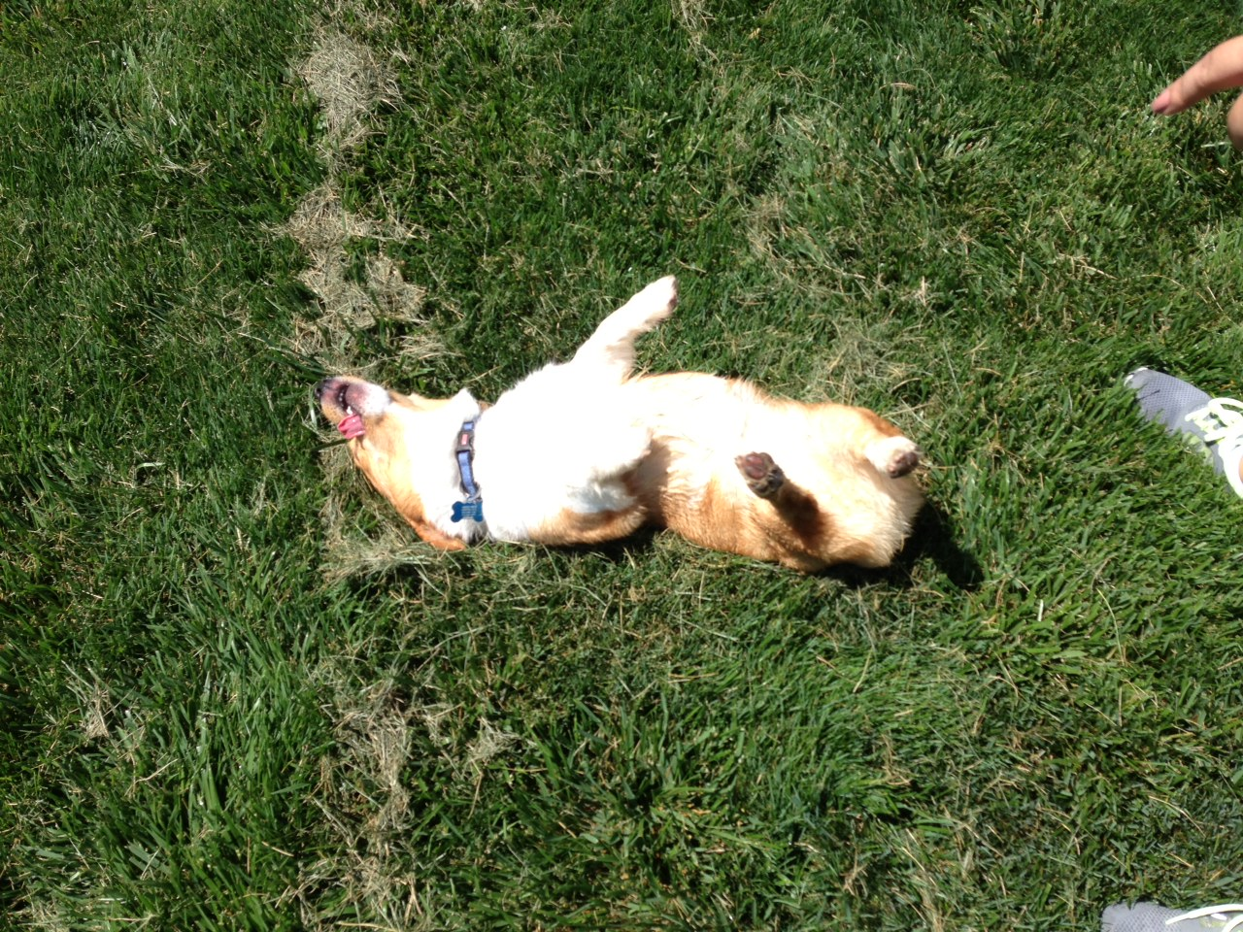
HELP I’VE FALLEN
AND I CAN’T GET UP

Slide 8
Next Steps
Create interface for users to define their own voice and gesture commands
Take advantage of Kinect 2’s enhanced sensors
Improved gesture commands/accuracy
Add hand gestures
Sensing heart rate for heart attacks/abnormal activity
Detect falling or other bodily accidents
Notes:
http://thenextweb.com/microsoft/2013/05/22/the-new-xbox-one-kinect-tracks-your-heart-rate-happiness-hands-and-hollers/

Slide 9
DEMO

